Slide 1


Modeling, Measuring, and Limiting Adversary Knowledge
Piotr (Peter) Mardziel

Slide 2
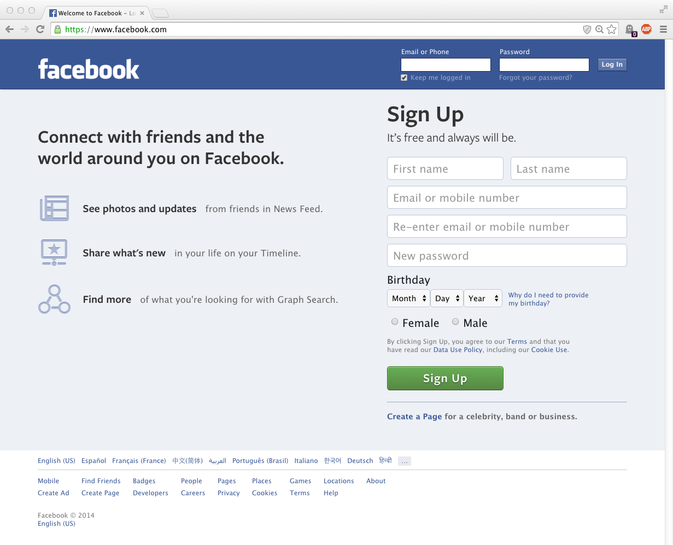

Slide 4
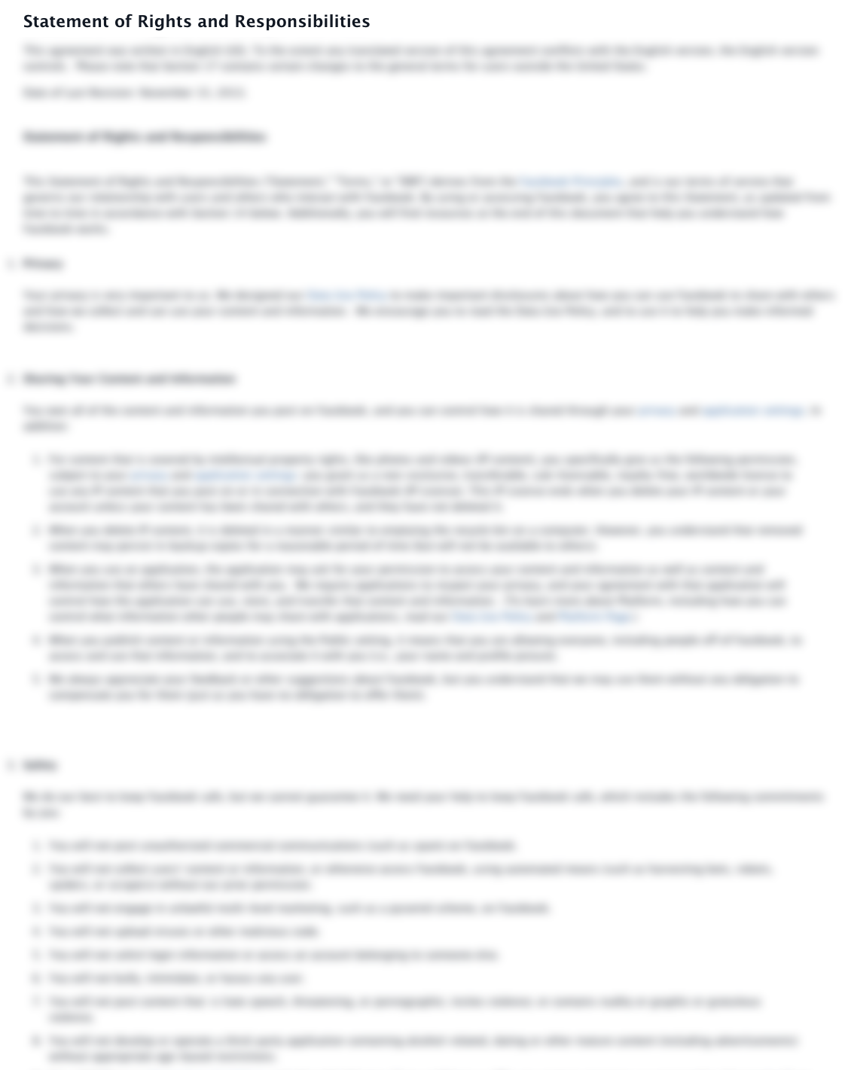
WE OWN YOU

Slide 5
WE OWN YOUR DATA

Slide 6

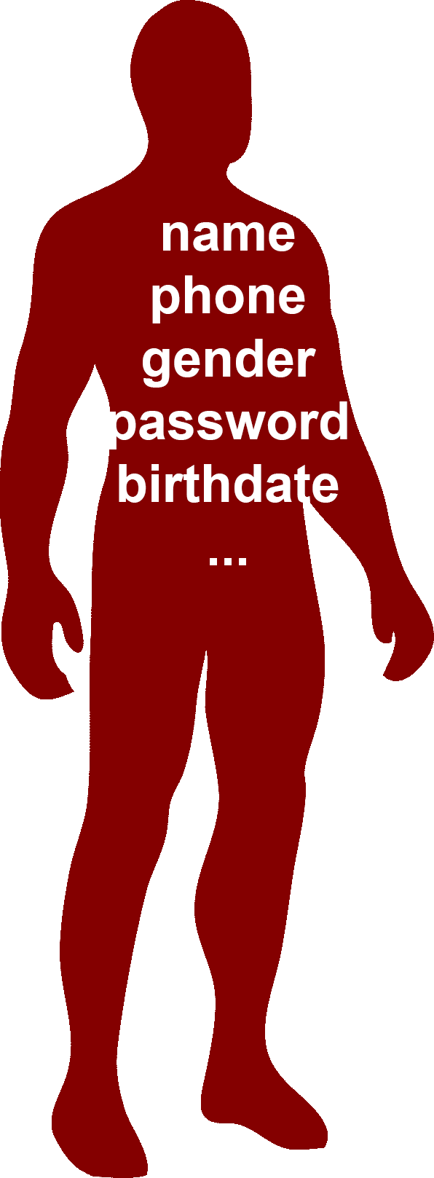

Slide 7
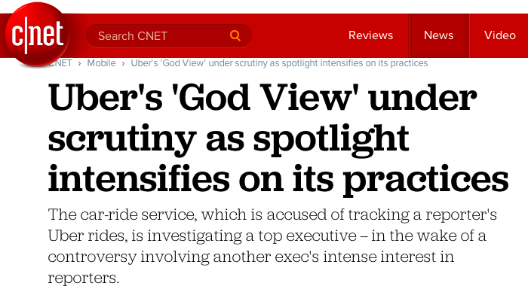
“If you’re not paying, you’re the product.”

Slide 8


Slide 9
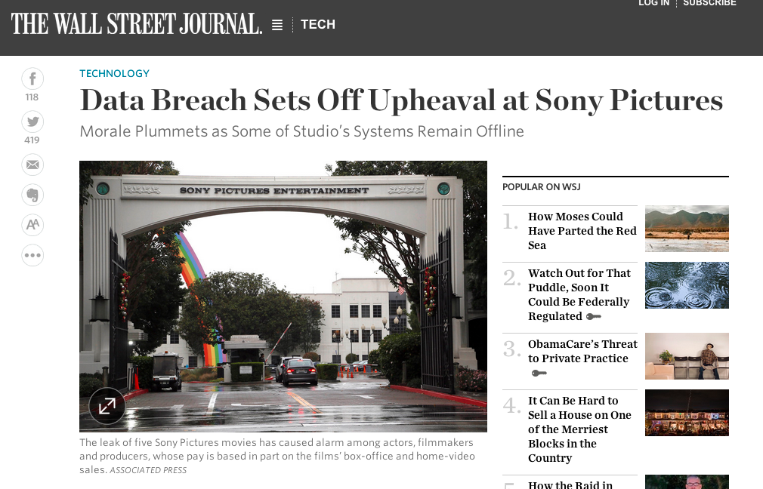

Slide 10

data misuse
(intentional or unintentional)

Slide 11

Alternative?
Notes:
Todo: label: alternative

Slide 12
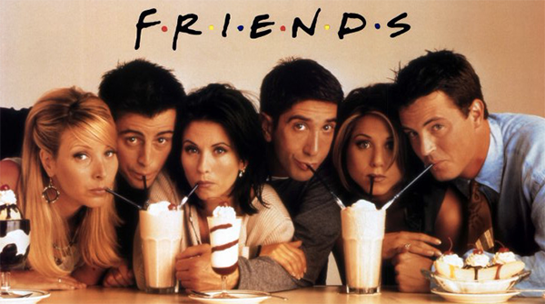
“Useful” Social Interactions
Alternative?
Economic Incentives
For Useful Services
Notes:
Todo: label: alternative

Slide 13
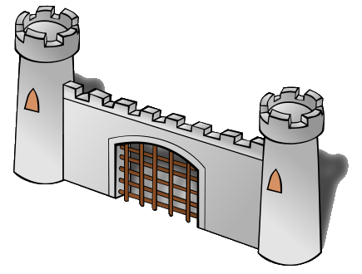
Alternative:
Query interface under your control

Slide 14
Which one of us is oldest?
What is your name, birthdate, gender?
Alternative:
Query interface under your control
Is your birthday within the next week?

Slide 15
Which one of us is oldest?
What is your name, birthdate, gender?
Support collaborative queries
REJECT risky requests
Alternative:
Query interface under your control
Is your birthday within the next week?
Answer benign requests

Slide 16
Which one of us is oldest?
What is your name, birthdate, gender?
???
???
Alternative:
Query interface under your control
Is your birthday within the next week?
???
Need:
Means to distinguish benign requests from malicious ones.

Slide 17
Safe (Online) Sharing
Pervasive Topic

Slide 18




sensor network,
resource allocation,
…

Slide 19
Safe (Online) Sharing
sensor network,
resource allocation,
…

Slide 20
Offline vs. Online Sharing
Sanitize ahead of time, release once
Fixed information
Need to know what is of interest
Release as requested
Information tailored to request
Decide to release or not when needed
Do not need to know what is of interest

Slide 21
Initial observations
Benign vs. Malicious
Prior Release
Automation

Slide 22
What is your name, birthdate, gender?
Risk
Here you go …

Slide 23
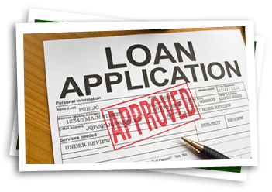
What is your name, birthdate, gender?
Risk
Likelihood of bad outcome
Here you go …

Slide 24
What is your name, birthdate, gender?
Risk
Likelihood of bad outcome
This talk:
adversary guesses secret
“vulnerability”
Here you go …

Slide 25
Initial observations
Benign vs. Malicious
Prior Release
Automation

Slide 26
Risk depends on what has already been revealed.
Is your birthday within the next week?

Slide 27
Risk depends on what has already been revealed.
Yesterday: Is your birthday within the next week?
No
Is your birthday within the next week?

Slide 28
Initial observations
Benign vs. Malicious
Prior Release
Automation

Slide 29
…
Mechanical solution necessary.
Is your birthday within the next week?
…

Slide 30
… …
Mechanical solution necessary.
Is your birthday within the next week?
… …

Slide 31
… … …
Mechanical solution necessary.
Is your birthday within the next week?
… … …

Slide 32
5 Months Later
Mechanical solution necessary.
Is your birthday within the next week?
… … …
yes

Slide 33
5 Months Later
Mechanical solution necessary.
Is your birthday within the next week?
… … …
yes

Slide 34
Initial observations
Benign vs. Malicious
Prior Release
Automation

Slide 35


Modeling, Measuring, and Limiting Adversary Knowledge
Model adversary knowledge
Integrate prior answers
Measure risk of bad outcome
Vulnerability: probability of
guessing
Limit risk
Reject questions with high
resulting risk

Slide 36
Confidentiality can be enforced by deciding whether to share based on evolving models of adversary knowledge*
*disclaimers
Notes:
TODO: insert thesis

Slide 37
Modeling, Measuring, and Limiting Adversary Knowledge
[CSF11,JCS13]
Limit risk and computational aspects of approach
[PLAS12]
Limit risk for collaborative queries
[S&P14,FCS14]
Measure risk when secrets change over time

Slide 38
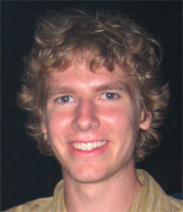


Modeling, Measuring, and Limiting Adversary Knowledge
[CSF11,JCS13]
Limit risk and computational aspects of approach
[PLAS12]
Limit risk for collaborative queries
[S&P14,FCS14]
Measure risk when secrets change over time
Stephen Magill
Galois
Michael Hicks
UMD
Mudhakar Srivatsa
IBM TJ Watson
Research Center

Slide 39

Model/Measure/Limit

Slide 40

Model
Prior/Background Knowledge

Slide 41
Model
If I answer Q1
Prior/Background Knowledge
If I don’t answer

Slide 42
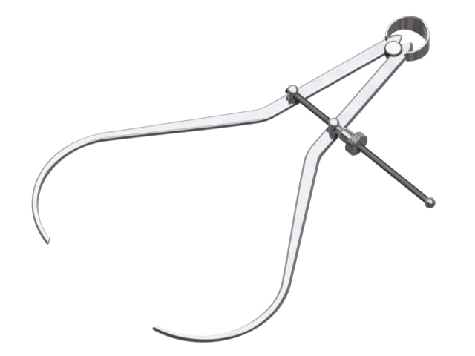
Measure
Tolerable risk
If I answer Q1
Prior/Background Knowledge
If I don’t answer

Slide 43
Model
Prior/Background Knowledge
I answered Q1

Slide 44
Measure
Intolerable risk
If I answer Q2
Prior/Background Knowledge
I answered Q1
If I don’t answer

Slide 45
Limit
Intolerable risk
If I answer Q2
Prior/Background Knowledge
I answered Q1
If I don’t answer

Slide 46
Model
Prior/Background Knowledge
I answered Q1
I rejected Q2

Slide 47
Example: Birthday
Is your birthday within the next week?
?

Slide 48
Example: Birthday
bool Q1(int bday) {
return (bday ≥ 270 and
bday < 270+7)
}
?
Notes:
Todo: emphasize important and diminish unimportant

Slide 49
Modeling knowledge
Prior knowledge: a probability distribution
Pr[bday = x] = 1/365 for 1 ≤ x ≤ 365

Slide 50
Example: Birthday
bool Q1(int bday) {
return (bday ≥ 270 and
bday < 270+7)
}
true
bday=270
Notes:
Todo: emphasize important and diminish unimportant

Slide 51
Modeling knowledge
Prior knowledge:
Pr[bday=x] = 1/365 for 1 ≤ x ≤ 365
Posterior knowledge given Q1(bday) = true
Pr[bday=x | true] = 1/7 for 270 ≤ x ≤ 276
Elementary* probability
*If you have Pr[Q1(X) | X] and Pr[Q1(bday)]
Notes:
Todo: mention probabilistic computation and Q1 is a general program

Slide 52
Measure risk
Risk* = probability of most probable value
Prior knowledge:
Pr[bday=x] = 1/365 for 1 ≤ x ≤ 365
Risk: 1/365 probability of guessing bday
Posterior knowledge given Q1(bday) = true
Pr[bday=x | true] = 1/7 for 270 ≤ x ≤ 276
Risk: 1/7 probability of guessing bday
* details

Slide 53
Limit via Risk Threshold
Answer if risk ≤ t

Slide 54
Limit via Risk Threshold
Answer if risk ≤ t
How to pick threshold t? What is tolerable?
Notes:
Todo: emphasize limit risk , add slide for this

Slide 55
Vulnerability
Vulnerability = V
Incur loss of $L if your secret is guessed
Expected loss = $V*L
* details

Slide 56
Example: Birthday
If I answer Q1, the adversary will have 1/7 probability of guessing my bday.
Assume risk ≤ 1/2 is tolerable.

Slide 57
Example: Birthday
bool Q1(int bday) {
return (bday ≥ 270 and
bday < 270+7)
}
true
bday=270
Notes:
Todo: emphasize important and diminish unimportant

Slide 58
Birthday: next day
bool Q1(int bday) {
return (bday ≥ 270 and
bday < 270+7)
}
bool Q2(int bday) {
return (bday ≥ 271 and
bday < 271+7)
}
true
false?
bday=270
Notes:
Todo: emphasize important and diminish unimportant

Slide 59
Measure risk
Prior knowledge (given Q1)
Pr[bday=x | true] = 1/7 for 270 ≤ x ≤ 276
Risk: 1/7 probability of guessing bday
Posterior knowledge (given Q1,Q2)
Pr[bday=x | true,false] = 1 when x = 270
Risk: 100% chance of guessing bday

Slide 60
Limit risk
If I answer Q2, the adversary will have 100% chance of guessing my bday.
Not tolerable.
So, reject Q2?

Slide 61
Birthday: next day
bool Q1(int bday) {
return (bday ≥ 270 and
bday < 270+7)
}
bool Q2(int bday) {
return (bday ≥ 271 and
bday < 271+7)
}
true
Reject
bday=270
Notes:
Todo: emphasize important and diminish unimportant

Slide 62
Birthday: next day (Alternate Reality)
bool Q1(int bday) {
return (bday ≥ 270 and
bday < 270+7)
}
bool Q2(int bday) {
return (bday ≥ 271 and
bday < 271+7)
}
true
true
bday=271
Notes:
Todo: emphasize important and diminish unimportant

Slide 63
Birthday: next day (Alternate Reality)
bool Q1(int bday) {
return (bday ≥ 270 and
bday < 270+7)
}
bool Q2(int bday) {
return (bday ≥ 271 and
bday < 271+7)
}
true
true
271≤bday≤276
Notes:
Todo: emphasize important and diminish unimportant

Slide 64
Measure risk
Assuming adversary knows Alice’s tolerable threshold: ½ (or anything < 1)
Output true implies 271 ≤ bday ≤ 276
Reject implies bday = 270
Notes:
TODO: write this in prose

Slide 65
Recall: Model
If I answer Q1
Prior/Background Knowledge
If I don’t answer

Slide 66
Measure risk
Problem: risk measurement depends on the value of the secret

Slide 67
Recall: Model
If I answer Q1 with Q1(bday)
Prior/Background Knowledge
If I don’t answer

Slide 68
Measure risk
Problem: risk measurement depends on the value of the secret
Solution: limit risk over all possible outputs (that are consistent with adversary’s knowledge)
“worst-case vulnerability”

Slide 69
Worst-case Vulnerability
If I answer Q1 with true
If I answer Q1 with false
✔
Prior/Background Knowledge
If I don’t answer

Slide 70
Implementation
Probabilistic programming:
Given Pr[bday], program Q1
Compute Pr[bday | Q1(bday) = yes]
Problem: undecidable/intractable when possible

Slide 71
Implementation
Probabilistic programming:
Given Pr[bday], program Q1
Compute Pr[bday | Q1(bday) = yes]
Problem: undecidable/intractable when possible
Solution: sound approximation

Slide 72
Probability Distributions
Prior knowledge:
Pr[bday=1] = 1/365
Pr[bday=2] = 1/365
Pr[bday=3] = 1/365
Pr[bday=4] = 1/365
Pr[bday=5] = 1/365
…

Slide 73
Probability Abstraction
Prior knowledge:
Pr[bday=x] = 1/365 for 1 ≤ x ≤ 365
Pr[bday=x]
1/365
[
]
1
365
x

Slide 74
Probability Abstraction
Posterior given Q1(bday) = false:
Pr[bday=x | …] = 1/358
for 1 ≤ x ≤ 269, 277 ≤ x ≤ 365
Pr[bday=x | …]
1/358
[
]
[
]
1
269
277
365
x

Slide 75
Probability Abstraction
Probability distribution abstraction:
Sum of convex regions with probability bounds.
Pr[bday=x | …]
← For vulnerability
1/358
← For sound inference
[
]
[
]
1
269
277
365
P1
x
P2

Slide 76
Probability Abstraction
Probability distribution abstraction:
Sum of convex regions with probability bounds.
Pr[bday=x | …]
← For vulnerability
1/358
← For sound inference
[
]
[
]
1
269
277
365
P1
x
P2

Slide 77
Probability Abstraction
Probability distribution abstraction:
Can represent distributions over large state spaces efficiently
Do not need to know exact prior
Notes:
Todo: maybe include enumeration vs. abstraction

Slide 78
Modeling, Measuring, and Limiting Adversary Knowledge
[CSF11,JCS13]
Limit risk and computational aspects of approach
Simulatable enforcement of risk limit
Probabilistic abstract interpreter based on, intervals, octagons, and polyhedra
Approximation: tradeoff precision and performance
Inference sound relative to vulnerability

Slide 79
Modeling, Measuring, and Limiting Adversary Knowledge
[CSF11,JCS13]
Limit risk and computational aspects of approach
[PLAS12]
Limit risk for collaborative queries
[S&P14,FCS14]
Measure risk when secrets change over time

Slide 80
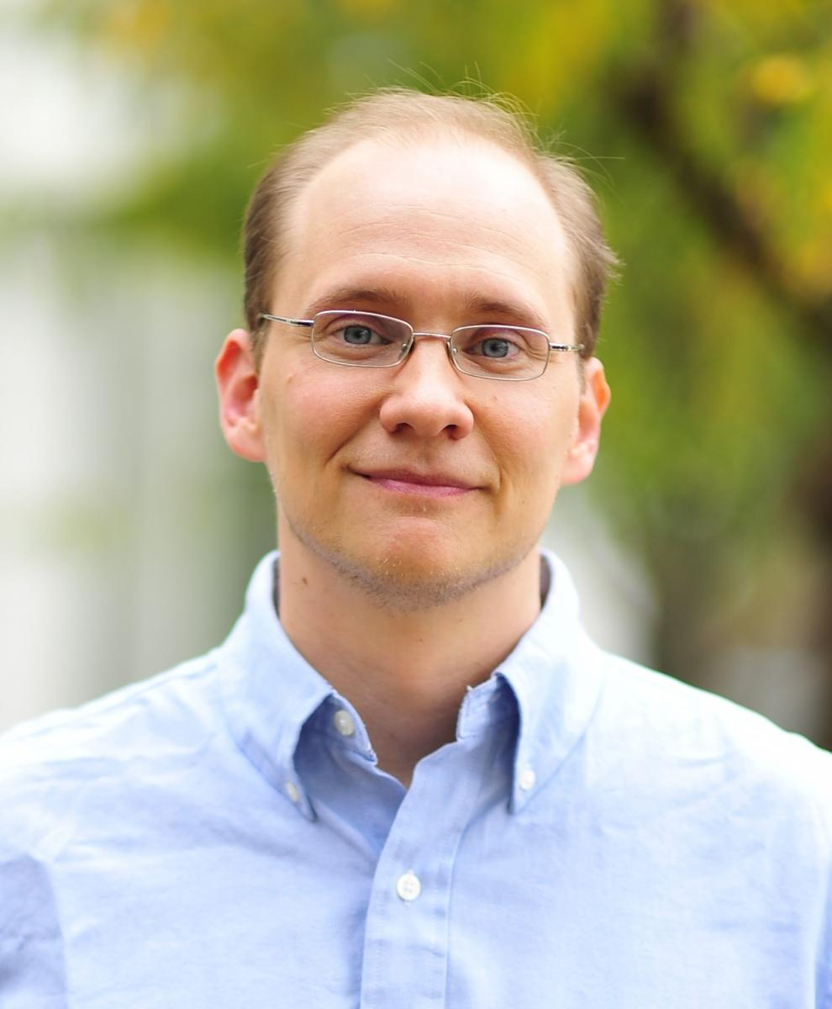
Modeling, Measuring, and Limiting Adversary Knowledge
[CSF11,JCS13]
Limit risk and computational aspects of approach
[PLAS12]
Limit risk for collaborative queries
[S&P14,FCS14]
Measure risk when secrets change over time
Michael Hicks
UMD
Jonathan Katz
UMD
Mudhakar Srivatsa
IBM TJ Watson
Research Center

Slide 81
Bob
Which one of us is oldest?
Alice

Slide 82
Bob
bdayB=300
bool Q3(int bdayA, int bdayB) {
return bdayA <= bdayB
}
?
Alice
bdayA=270

Slide 83
Bob
bdayB=???
bool Q3(int bdayA, int bdayB) {
return bdayA <= bdayB
}
?
Alice
bdayA=270

Slide 84
Bob
bdayB=???
bool Q3(int bdayA, int bdayB) {
return bdayA <= bdayB
}
HOW
?
Is this even possible?
Alice
bdayA=270

Slide 85
Collaborative queries
Secure multi-party computation
Parties can compute Q3(bdayA,bdayB) without revealing bdayA/bdayB to each other*
Emulate the trusted 3rd party using cryptographic protocol
Notes:
Todo: add pictures

Slide 86
Collaborative queries
Secure multi-party computation
Parties can compute Q3(bdayA,bdayB) without revealing bdayA/bdayB to each other*
Emulate a trusted 3rd party using cryptographic protocol
* Beyond what is implied by the output

Slide 87
bdayB=300
Bob
bdayB=???
true
true
Trusted
3rd party
bdayA=270
Alice
bdayA=270

Slide 88
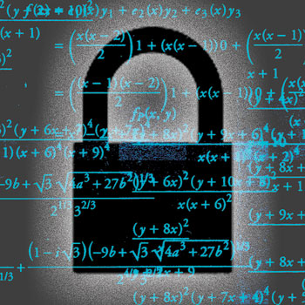
bdayB=300
Bob
bdayB=???
true
true
Trusted
3rd party
bdayA=270
Alice
bdayA=270

Slide 89
Model/Measure/Limit
If I answer Q3 with true
If I answer Q3 with false
Prior/Background Knowledge
If I don’t answer

Slide 90
Modeling knowledge Alice’s Perspective
Bob’s prior knowledge about Alice’s bdayA:
Pr[bdayA=x] = 1/365 for 1 ≤ x ≤ 365

Slide 91
Modeling knowledge
✔
If I answer Q3 with true
If I answer Q3 with false
Prior/Background Knowledge
If I don’t answer

Slide 92
Modeling knowledge
If I answer Q3 with true
If I answer Q3 with false
Prior/Background Knowledge
If I don’t answer

Slide 93
Modeling knowledge
Bob’s prior knowledge about Alice’s bdayA:
Pr[bdayA=x] = 1/365 for 1 ≤ x ≤ 365
Posterior knowledge given Q3(bdayA,bdayB) = true (so bdayA ≤ bdayB)
Pr[bdayA=x | true] = ??? for ???

Slide 94
Modeling knowledge
Problem: Bob’s posterior knowledge about Alice’s data depends on Bob’s secret value

Slide 95
Modeling knowledge
Problem: Bob’s posterior knowledge about Alice’s data depends on Bob’s secret value
If bdayB was 365: Q3(bdayA,bdayB) = true
Pr[bdayA= x | true] = 1/365 for 1 ≤ x ≤ 365
If bdayB was 1: Q3(bdayA,bdayB) = true
Pr[bdayA = x | true] = 1 for x = 1
And anything in between.
Notes:
Todo: better names than bday1,bday2

Slide 96
Modeling knowledge
Problem: Bob’s posterior knowledge about Alice’s data depends on Bob’s secret value
Solution 1: consider all possible values of Bob’s secret:
“worst-worst-case vulnerability”

Slide 97
Worst-case Vulnerability
If I answer Q3 with true
If I answer Q3 with false
Prior/Background Knowledge
If I don’t answer

Slide 98
Worst-Worst-case Vulnerability
When bdayB = 1
If I answer Q3 with true
If I answer Q3 with false
Prior/Background Knowledge
If I don’t answer

Slide 99
Worst-Worst-case Vulnerability
When bdayB = 1
When bdayB = 2
If I answer Q3 with true
If I answer Q3 with true
If I answer Q3 with false
If I answer Q3 with false
Prior/Background Knowledge
If I don’t answer

Slide 100

Extremely Conservative

Slide 101
Modeling knowledge
Problem: Bob’s posterior knowledge about Alice’s data depends on Bob’s secret value
Solution 2: trust the trusted 3rd party to model, measure, and limit risk on your behalf
Trusted 3rd party knows what Bob’s secret value is

Slide 102
bdayB=300
Bob
Trusted 3rd Party
Risk to Alice ≤ tA ?
Risk to Bob ≤ tB ?
bdayB=???
bdayA=270
Alice
bdayA=270

Slide 103
bdayB=300
Bob
Trusted 3rd Party
Risk to Alice ≤ 1/2 ?
Risk to Bob ≤ 1/2 ?
bdayB=???
true
true
bdayA=270
Alice
bdayA=270

Slide 104
bdayB=1
Bob
Trusted 3rd Party
Risk to Alice ≤ 1/2 ?
Risk to Bob ≤ 1/2 ?
bdayB=???
Reject
Reject
Information
Leak
bdayA=270
Alice
bdayA=270

Slide 105
bdayB=1
Bob
Trusted 3rd Party
Risk to Alice ≤ 1/2 ?
Risk to Bob ≤ 1/2 ?
bdayB=???
Reject
true
bdayA=270
Alice
bdayA=270

Slide 106
Modeling, Measuring, and Limiting Adversary Knowledge
[PLAS12]
Limit risk for collaborative queries
Approach 1: Belief sets: tracking possible states of knowledge
Approach 2: Knowledge tracking as secure computation
Simulatable enforcement of risk limit
Experimental comparison of risk measurement for the two approaches.

Slide 107
Modeling, Measuring, and Limiting Adversary Knowledge
[CSF11,JCS13]
Limit risk and computational aspects of approach
[PLAS12]
Limit risk for collaborative queries
[S&P14,FCS14]
Measure risk when secrets change over time

Slide 108

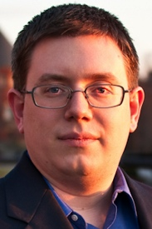
Modeling, Measuring, and Limiting Adversary Knowledge
[CSF11,JCS13]
Limit risk and computational aspects of approach
[PLAS12]
Limit risk for collaborative queries
[S&P14,FCS14]
Measure risk when secrets change over time
Mário Alvim
Universidade Federal
de Minas Gerais
Michael Hicks
UMD
Michael Clarkson
Cornell

Slide 109
Modeling, Measuring, and Limiting Adversary Knowledge
Secrets change
Moving target, recovery of uncertainty
Secrets are correlated
Prediction
Optimal adversary behavior
Monotonic risk

Slide 110
Model
Risk (guessing bday)
Risk (guessing bday)
Risk (guessing bday)
Time 0:
Prior knowledge
Time 1:
I answered Q1(bday)
Time 2:
I answered Q2(bday)

Slide 111
Secrets Change
Risk (guessing bday)
Risk (guessing bday)
Risk (guessing bday)
Time 0:
Prior knowledge
Time 1:
I answered Q1(bday)
Time 2:
I answered Q2(bday)

Slide 112
Secrets Change
Risk (guessing loc0)
Risk (guessing loc0)
Risk (guessing loc0)
Time 0:
Prior knowledge
Time 1:
I answered Q1(loc1)
Time 2:
I answered Q2(loc2)

Slide 113
Secrets Change: Moving Target
Risk (guessing loc0)
Risk (guessing loc1)
Risk (guessing loc2)
Time 0:
Prior knowledge
Time 1:
I answered Q1(loc1)
Time 2:
I answered Q2(loc2)

Slide 114

Decreasing Risk
☹
Secret changes
☺
prior
Q₁
Q₂
Q₃
…
Notes:
Todo: generate better figure

Slide 115
Correlation
Risk (guessing loc0)
Risk (guessing loc1)
Risk (guessing loc2)
Δ
Δ
Time 0:
Prior knowledge
Time 1:
Nothing new revealed
Time 2:
Nothing new revealed
I have a ticket for BOS → HNL for Saturday morning.

Slide 116
Prediction
Risk (guessing loc0)
Expected Risk (guessing loc1)
Expected Risk (guessing loc2)
Δ
Δ
Time 0:
Prior knowledge
Time 1:
Nothing new revealed
Time 2:
Nothing new revealed
Future
Present

Slide 117
Model for Dynamic Secrets
Risk (guessing loc0)
Expected Risk (guessing loc1)*
Expected Risk (guessing loc2)*
Δ
Δ
Time 0:
Prior knowledge (loc0)
Prior knowledge (Δ)
Time 1:
I answered Q*(loc1)
Time 2:
I answered Q*(loc2)
Future
Present

Slide 118
Model for Dynamic Secrets
Risk (guessing loc0)
Expected Risk (guessing loc1)*
Expected Risk (guessing loc2)*
Δ
Δ
Time 0:
Prior knowledge (loc0)
Prior knowledge (Δ)
Time 1:
I answered Q*(loc1)
Time 2:
I answered Q*(loc2)
* Optimal adversary behavior
Future
Present

Slide 119
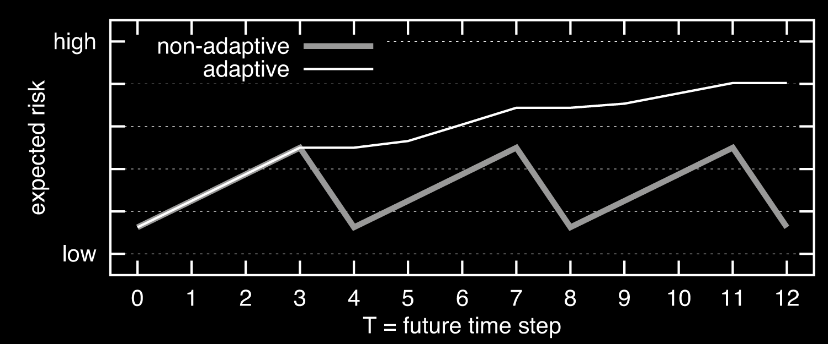
Monotonic Risk
☹
☺
prior
Q₁
Q₂
Q₃
…
Notes:
Todo: generate better figure

Slide 120
Tradeoff
Hide locT or hide Δ
A more frequently changing secret can result in higher risk in some cases

Slide 121
Modeling, Measuring, and Limiting Adversary Knowledge
[S&P14,FCS14]
Measure risk when secrets change over time
Model of risk with dynamic secrets and adaptive adversaries
Model separating risk to user from gain of adversary
Implementation and experimentation with small scenarios

Slide 122
Modeling, Measuring, and Limiting Adversary Knowledge
[CSF11,JCS13]
Limit risk and computational aspects of approach
[PLAS12]
Limit risk for collaborative queries
[S&P14,FCS14]
Measure risk when secrets change over time

Slide 123
Present/Future
Probabilistic computation, SMC (not mentioned)
Make go fast(er)
Changing secrets
Characterize/avoid pathological cases
Active defense
Game theory

Slide 124
Sharing on Your Own Terms
Piotr (Peter) Mardziel
piotrm@gmail.com

